Slide 1
S/4HANA Cloud 1
Velocity and Estimation
Concept playbook
DRAFT

Slide 2






Velocity Concept
Estimations
Concept
Roll out best practices

Slide 3

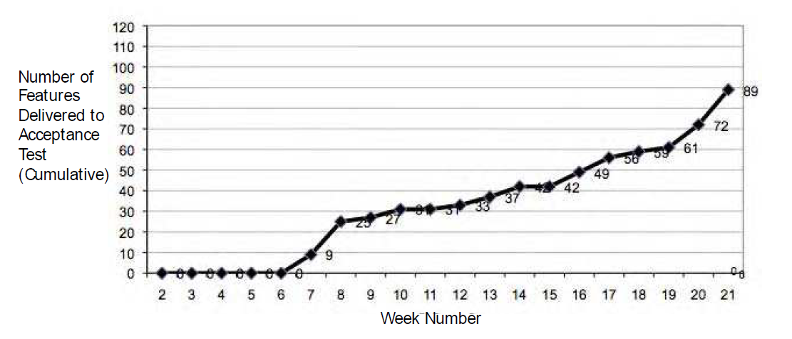
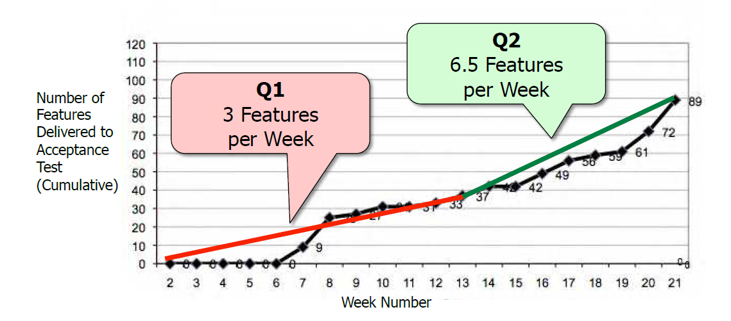
Velocity :
Velocity is calculated as sum of backlog items completed per sprint
Velocity: Number of items shipped by the team which adds value to the product stack per takt.
Usable and shippable backlog items are account in velocity
Bugs, maintenance, research, PoCs, activities are NOT accounted in velocity

Slide 4
Backlog items should be sliced in uniform sizes to have a meaningful velocity metric
Backlog items should be completed within a sprint
Backlog items should have similar person-day effort (7-10 PD)
Sprint 1
Sprint 2
Sprint 3
7 PD
10 PD
5 PD
9 PD
8 PD
7 PD
4 PD
4 PD
8 PD
8 PD
3
3
4
Average Velocity: 3,3

Slide 5
Benefits:
Benefit for the development team​
It helps them to measure whether the changes done in internal team processes are helping in improving the efficiency or not​
It helps them to plan and take only what it can be achieved based on historical data​, which in turn helps the team to deliver on the work which has been committed
Benefit for the PO​
It helps them to understand how many of the product backlogs items might get completed by a team within a sprint / release​
It helps coordinating with functional PM on estimating how long the development of ”Function” may take
Overall benefits​
Velocity using number of backlog items is standardized across multiple teams, which in turn gives a higher confidence on the commitments and timelines done during release planning for cross-team e2e requirements

Slide 6
Velocity should be observed in conjunction with Cycle Time
Cycle Time: days elapsed from the time the item(BLI) went from In Progress to Done.
Velocity
Cycle Time
Work per Time
Time per Work
A high velocity may indicate a low cycle time
A low velocity may indicate a high cycle time

Slide 7
Concept: Release Burn-Up is similar to the sprint burn-down, but takes into account changes in the scope and reflects the work already done
Release burn-up
Description
Graph that compares the completed work in a release, measured by number of backlog items, against the planned work
Reflects how much work has been done, the goal is to hit the roof (release scope)
Reflects changes in the scope during the release
Goal
Provides an overview on how the team is performing against the release goal
Serve as a visual tool to help manage each release
How to see
Sprint Burndown can be easily seen in JIRA under reports > Burnup chart
Currently not supported natively by SAP JIRA v7.13.8
Backlog items completed
Backlog Items
Backlog items plan
50
Decreased scope
Release scope
45
40
Increased scope
35
30
25
Team is behind plan
20
Team is ahead of plan
15
10
5
0
0
1
2
3
4
5
6
7
8
9
10
Sprints
Supported by latest JIRA version, teams can utilize the chart when available

Slide 8
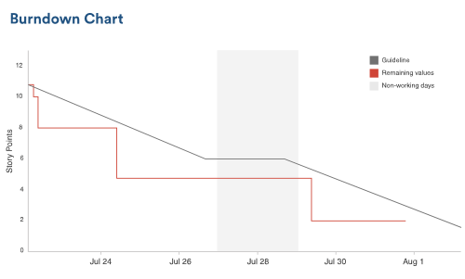
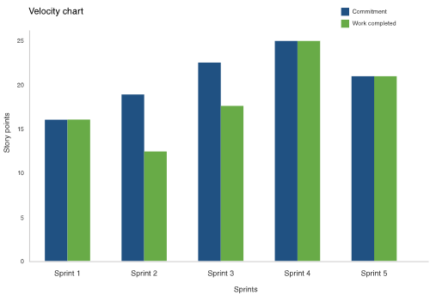
Burndown and velocity charts are useful tools to track value delivered
Burndown chart shows completion of work during the sprint
Velocity chart shows amount of value delivered in each sprint
Anti-patterns to watch for:
Team finishes sprint after sprint early because it doesn’t commit to enough work
Team misses it’s forecast sprint after sprint because it commits to too much work
Burndown line makes steep drops rather than burns gradually because the work hasn't been broken down into granular enough pieces
Product owner adds work or changes the scope mid-sprint
Anti-patterns to watch for:
When velocity is erratic over a long period of time, always revisit team's estimation practices
Are there unforeseen challenges team didn't account for when estimating the work? How can it better break down work to uncover some of the challenges?
Is there outside business pressure pushing the team beyond its limits? Are development best practices suffering as a result?
Is the team overzealous in forecasting for the sprint?

Slide 9
Example: How to use velocity during sprint planning
Size the sprint based on velocity
Execute on the Sprint plan
Close-out sprint
Historical velocity = 8 backlog items / sprint
Backlog item
Backlog item
Backlog item
Observed velocity = 2 backlog items / sprint
Backlog item
Backlog item
Backlog item
Backlog item
Team works on the tasks committed on
Into next sprint
Backlog item
Backlog item
PO along with team breaks down Sprint backlog into tasks and creates a Sprint plan to track
Team develops and tests the list of features in the Sprint backlog
Team concludes with a review of the Working Software
Over the course of 3-5 sprints, as the team’s understanding of estimates improves, velocity stabilizes.
If the variability between estimated and actual velocity doesn’t go down across sprints, it may indicate some problem

Slide 10


Velocity:
Measure Backlog only
Don’t measure Bug, Activity,..
Measure for Sprint only
Don’t measure for release

Slide 11
Audience:
Product Owner
Scrum Master

Slide 12
Velocity Concept
Estimations
Concept
Roll out best practices

Slide 13
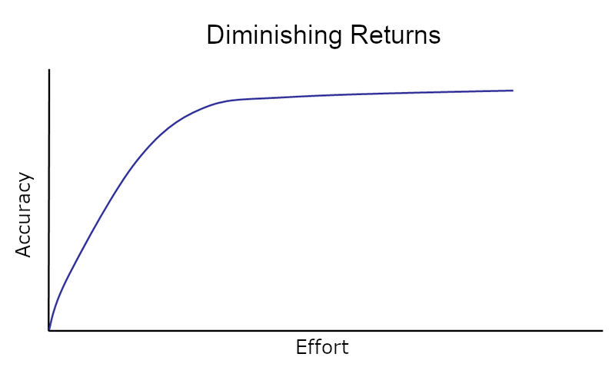
Estimations help in estimating complexity of work and how much work can be done in a sprint
What is estimation
Quantified evaluation of the effort needed to carry out a specific task
A way to tell how hard the story is
A group exercise, as group-derived estimates are demonstrably more accurate than estimates by individuals
What is the purpose of estimation
Allow to predict when a Sprint goal will be met
Help stakeholders to plan ahead
Help us de-risk scope of uncertain size and complexity
Estimated work can be traded in and out of scope for other work of similar size
Gain a better understanding of what is needed to develop the solution. The very process of estimation adds value. When we estimate we discuss requirements in more detail.
Together, we are smarter than any one of us.
– Japanese proverb

Slide 14

There are several techniques which can be used to estimate a product backlog
Relative estimation technique
T-shirt sizes
Backlog items are classified into t-shirt sizes: XS, S, M, L, XL.
This method is an informal and quick way to get a rough feeling about the total size of your backlog
Story Points
Backlog items are classified into buckets with a numerical value, following the Fibonacci scale.
The method doesn’t follow a linear scale.
Time Estimations
Time estimations assign to every backlog item a certain number of man-hours or days.
This allows to easily predict the sprint output based on the team’s capacity
Backlog Item Splitting / No Estimate
Backlog items are all split roughly on the same size.
E.g. they should all be completed in around four man-days.
Hence no estimation is necessary
story #1
(8 man-days)
story #1
(4 man-days)
1
2
3
5
8
13
21
story #1
S
M
L
8h
story #2
(4 man-days)
story #2
16h
S
story #3
story #3
(4 man-days)
story #3
(4 man-days)
32h

Slide 15
Comparison of different estimations techniques
No estimation/ Backlog Item Splitting
Time
T-shirt sizes
Story Points
Units
Hours or days (PD)
XS, S, M, L, XL, XXL
(simplified) Fibonacci
Backlog Item
Pros
Simple to understand
Over time more precise
Easy to estimate
Faster estimations
More relevant for big features and epics to plan a product roadmap
Levels out false estimations over time
Takes growing uncertainty of bigger tasks into account
Allows to have team velocity/pace
Saves time by not estimating
Cons
Could be understood as commitment
Estimation takes significant time
Not granular enough
Linear scale
Cannot be summed up consistently
Estimation takes time
High level of experience required
Stories are split for the sake of sizing

Slide 16
Teams can choose their preferred estimation method, but backlog items should still be sliced in similar sizes to track velocity for release planning purposes
Key Takeaways
Description
Teams choose their estimation method
Teams can choose the estimation method they are already used to and feel the most comfortable with
If a team is successful with time based estimations, they are encouraged to use it
Relative estimations techniques can be used for teams with variable workloads very difficult to estimate in concrete person-days
Teams should slice backlog items in similar sizes
For release planning transparency and predictability teams should size backlog items into small and uniform chunks
The target sizing, equates to 7-10 person days effort
Backlog items should be completed within a sprint
Some variability is inevitable, but across sprints this should average out
Velocity to be tracked in # of backlog items
All the teams are required to report velocity in # of backlog items completed to facilitate a consistent release planning process
However, for internal tracking, teams are free to compute velocity in story points as well
Labels should be used to track not related to current release
If a team needs to spend a lot of time doing improvements to previous release, like maintenance or performance improvements, they can use labels to cluster the time spent by activity
Through JIRA reporting tools, a team can have an insight on where the most time is spent

Slide 17
Velocity Concept
Estimations
Concept
Roll out best practices

Slide 18








High level roll-out plan to Velocity and Estimations
Roll out plan
Activities
Participants
Introduction session
Introduce the of velocity to the team and best practices to follow
Introduce the general options for doing estimations
Find out what is the status quo within the team and how sprint plannings are done
Entire team
1
Coach during sprint planning and refinement
Coach the team on estimations and help choose the most fitting method
Drive the estimations discussion during refinement, using for example planning poker
Make sure estimations are quick, foster constructive discussions and add value to the process
Help POs slice backlog items for which estimations are too high using slicing techniques
If historical velocity is available, make sure it’s used as reference during takt planning
Entire team
2
Revise
Evaluate accuracy of estimations after sprint end and discuss together with the team if there is a big difference with the actual effort
Analyze and discuss on the burndown chart
Entire team
3
Sustain adoption in subsequent Sprints
Over the course of multiple sprints, analyze the observed velocity
Find out if the metric is reliable and meaningful
Try to analyze the root causes of unpredictable velocity
Discuss feedback with CoPs
PO, Scrum Masters
4

Slide 19
Baseline KPIs to track success of rollout
Velocity is computed every sprint
Velocity should be visualized at the end of every sprint
Anomalies should be discussed in retrospective
Variability of velocity across sprints
Velocity should be compared to previous value
The variability across sprint should not be extreme, as it may indicate some issues (too many bugs?)
# of backlog items committed vs delivered
This may indicate poor estimations or unexpected complexities arising, unidentified dependencies, etc.

Slide 20



Key contacts from pilot teams and leadership
Name
Amit Mishra
Anurag
Contact
mishra.amit@sap.com
anurag@sap.com
Role in concept
Piloted the concept in FXU
Piloted the concept in FXU
SOURCE: aa

Slide 21
BACKUP

Slide 22
Contents
Deep dive on Story Points
Deep dive on No Estimates / Story Slicing

Slide 23
Story point estimation using Fibonacci scale has the greatest advantages in relation to time spent and accuracy
Advantages of Story Points vs
T-Shirt Sizes
Non-linear scale which help make decisive commitments about estimation and splitting
Offers a higher precision and enough buckets for estimations
Can be added up in a unambiguous way
Does not require extra conversion step to infer amount of work completed in a sprint
Very well supported in JIRA workflows and charting
Complexity
5
Effort
Advantages of Story Points vs
Story Splitting
Quicker to do, since splitting stories to reach a similar size can be very time consuming
Avoids artificially splitting a story to reach a equivalent size
Create discussion in the team which helps iron out uncertainties
Uncertainty
The Fibonacci sequence helps to incorporate uncertainty into the estimation

Slide 24
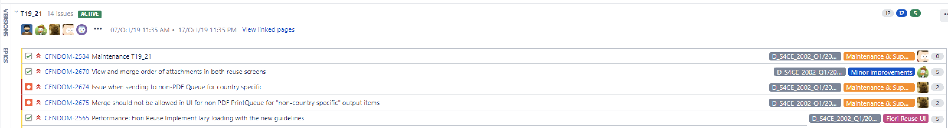
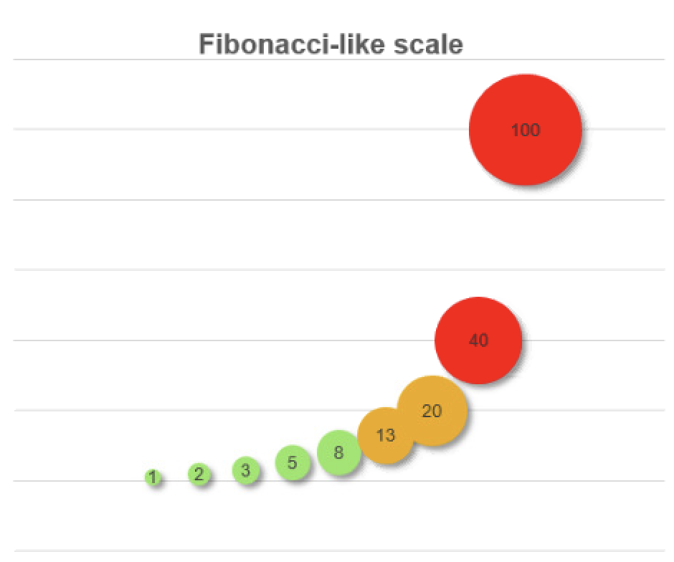
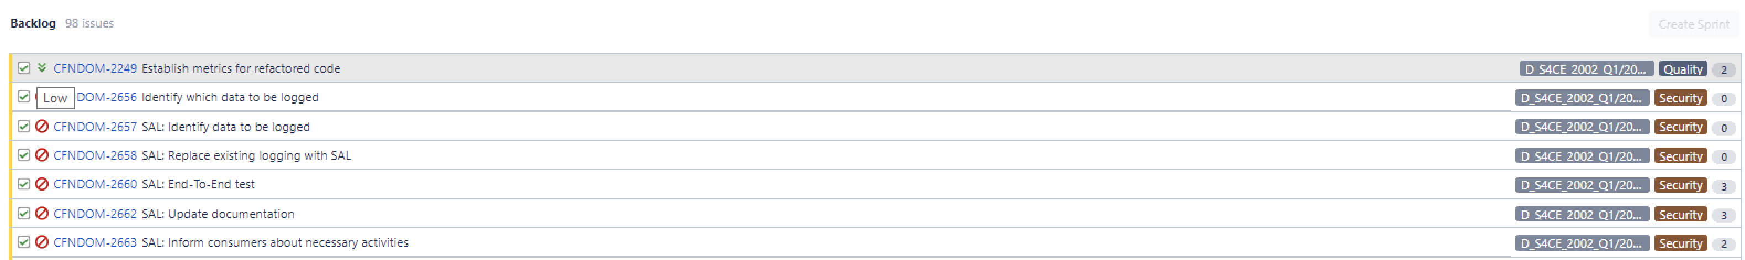
Story points estimates are already used successfully by some teams, like output management team or FXU in BRNO
Output Management Team
FXU Teams in BRNO
Story point is a unit that is commonly used across all FXU teams
Estimation in story points captures: complexity, effort, clarity, estimations are provided on the user-story level
Fibonacci-like scale is used to provide wide-enough buckets so that there is less quarrel when estimating stories by multiple different people.
Stories, backlog items and bugs in the current Sprint are estimated
Estimated and prioritized backlog
source: https://wiki.wdf.sap.corp/wiki/pages/viewpage.action?pageId=1908770706

Slide 25
Story points estimate complexity of work based on relative story size
What are story points?
How are story points deployed?
Team’s own relative estimate (compared to previous tasks) of the size and complexity of a task not just duration
A new unit of work different from traditional measures like hours – consistent with time – which enables performance follow-up (e.g., velocity metrics)
Estimation of user stories is done with the entire project team
The team estimates story points per story based on answering the following questions:
Complexity – how hard is it?
Uncertainty – what is not known?
Effort:
Volume – how much is there?
Knowledge – what do we know?
Relative values of user stories are important: A 2-point story should be twice as complex as a small story
Set up a maximum value of a story in a Sprint
A common one is using 13 SP as upper-bound for a story in a Sprint, if larger, it needs to be broken down
1
1
3
2
8

Slide 26



Example: The type of story determines the complexity of work and is measured in story points
Description of task
Estimated work size (in story points)
Level of complexity
Peeling a banana
Easy – Typically takes 4 easy pulls to fully peel the banana with no utensils required
Work size determined based on experience
A “relative sizing” of work is formed to estimate new stories by comparing those already estimated in the backlog
The term for the size measure is “story points”
1
Peeling an apple
Medium – Peel does not easily separate from fruit; requires use of vegetable peeler or paring knife
5
Peeling a watermelon
Hard – Fruit has very thick, hard rind that can only be “peeled” once the fruit is cut in quarters
“Story Points” use a Fibonacci series
1,2,3,5,8,13,21…?
13

Slide 27

Example: Poker planning sessions can be one option to deploy story point estimation in a team
Purpose
1
A team member provides a quick overview of the user story to be sized
Inspire discussion and drive consensus within the team w.r.t. absolute size of a single user story and relative size among user stories
2
Each team member independently estimates the level of complexity in story points relative to a baseline user story
3
Team votes and members with maximum/minimum scores provide rationale for score to other team members
Preparation
Estimation involves the entire team
The team agrees on estimation system to use (e.g., Fibonacci series: 1, 2, 3, 5, 8, 13, 21)
Considering the DoD for each story
The team has access to full list of stories in the backlog
Team identifies and reaches a consensus on the simplest story to be assigned a small which will be used as a basis for calculating complexity of other stories (baseline user story)
4
Team votes again and once consensus is reached story points are assigned
Relative precision is critical
Evaluators should consider the comprehensive complexity of implementing the feature (e.g., design, development and unit testing)

Slide 28
Velocity can be calculated with Story Points for teams with very variable workloads to help during planning
Velocity is the number of story points the team completes in a sprint – this is to be used only within the team
Velocity is a measure of the teams rate of progress
It is calculated by summing the number of story points assigned to each user story the team completes during the iteration
If the team completes 3 stories each estimated at 5 points, their velocity is 15
Velocity in Story Points should only help at team-level. For release planning, velocity as sum of backlog items will be used

Slide 29
Contents
Deep dive on Story Points
Deep dive on Story Slicing / No Estimates

Slide 30
When estimations do not provide significant value to every team, they can be avoided altogether
When to skip estimations
How to use “no estimates”
Slice backlog items on very small increments of similar size
Complete the sprint and observe the result throughput
Use this observed velocity as input in future planning meetings
When estimates are most of the time inaccurate, therefore pointless
When estimations takes so much time that they become counterproductive
When it‘s very difficult for team to agree on common values
When the backlog items are all of very similar effort
Even when avoiding estimations, the slicing process and the discussions had during refinement should help uncover uncertainty and hidden complexity

